Slide 1
Safety Tip
FQ18086
RHODE ISLAND AVENUE METRO STATION TRACK DECK AND PRE-CAST PANEL REHABILITATION
Please use full fall Protection gear when using 6’ or higher scaffolding during construction.

Slide 2
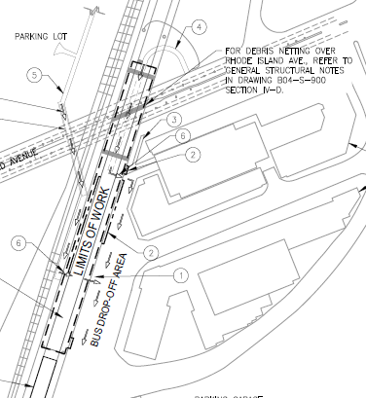
Technical Presentation
Project Location:
Project is at the Rhode Island Station on the Red Metrorail line.
Station Address:
919 Rhode Island Avenue NE Washington, DC 20018
Station Type:
Aerial Structure Station, Center Platform.

Slide 3
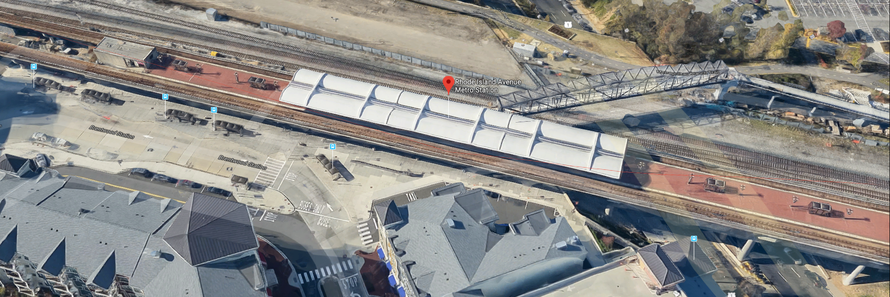
Technical Presentation

Slide 4
Technical Presentation
Work Limits:
Work is within the station platform limits and extends to cross Rhode Island Ave as per drawings (B04-G-003) .

Slide 5
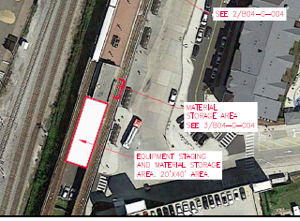
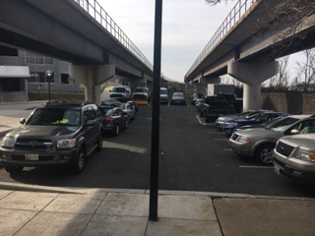
Technical Presentation
Staging & Storing : All staging area shall be secured and ensure public safety
Reference to staging area limits in Dwg. B04-G-004. South Parking entry way leading to fenced areas shall remain accessible all times. “No Parking” as indicated below:

Slide 6
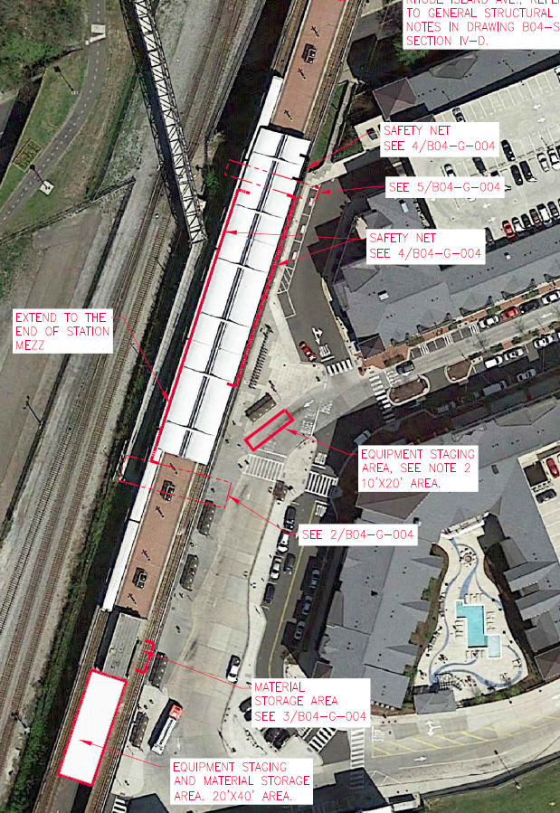
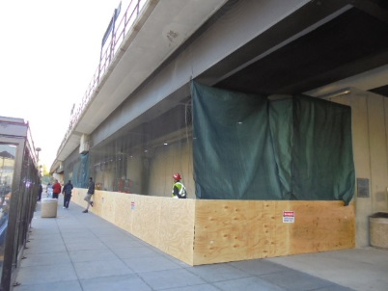
Technical Presentation
Staging & Storing : All staging area shall be secured and ensure public safety
Bus bay along the wall. Pedestrians safety requirements apply

Slide 7
Technical Presentation
Staging & Storing :
All staging area shall be secured and ensure public safety. Equipment staging spots shall be coordinated with WMATA COR.

Slide 8
Technical Presentation
Scope Of Work highlights:
Track Bed concrete spall repair.
Precast Concrete ceiling panels replacement.
Spall repair at Beam Bearing.
Lighting fixtures replacement.
Expansion joints Replacement.
Apply protective coating to track deck surface.

Slide 9
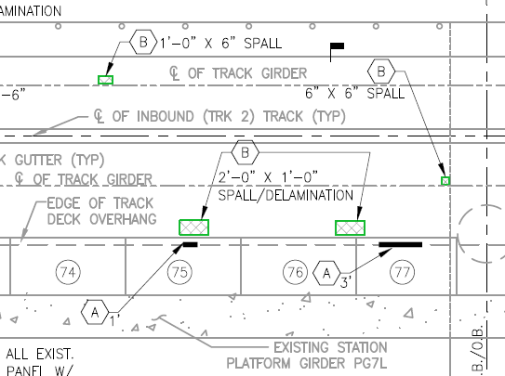
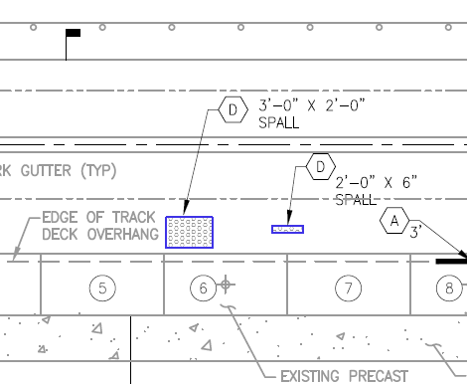
Technical Presentation
Track Bed concrete Spall Repair:
Multiple types or repair to Track Deck
Type A Edge repair
Type B overhead spall repair
Type D concrete top surface

Slide 10
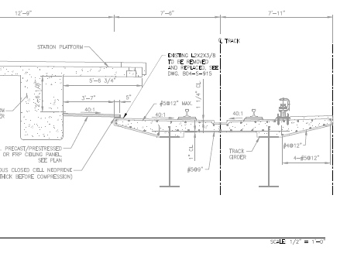
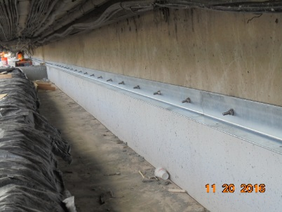
Technical Presentation
Precast concrete ceiling panels replacement:
WMATA provides portion of ceiling panel materials.

Slide 11
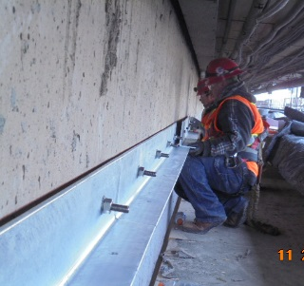
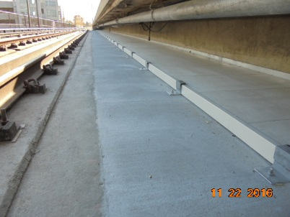
Technical Presentation
Precast concrete ceiling panels replacement:

Slide 12
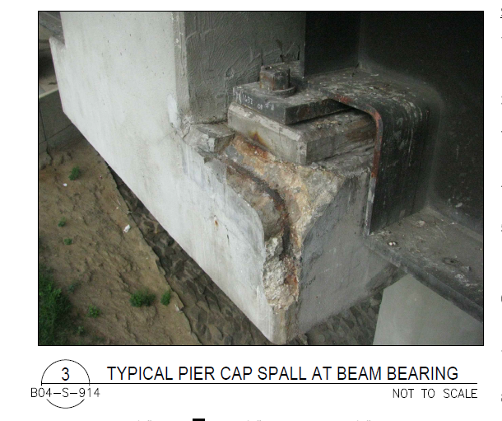
Technical Presentation
Spall repair at Beam Bearing:
Track 1 & 2 girders shall be jacked to repair the beams bearings.

Slide 13
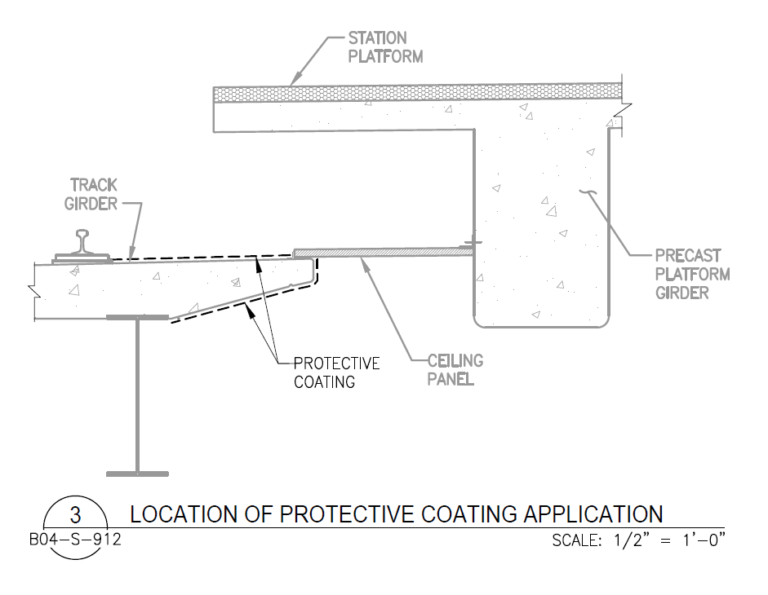
Technical Presentation
Apply Track Deck Protective coat.

Slide 14
Technical Presentation
Access to the work area during the shutdown period (from July 21 to Sep. 2, 2018).
WMATA’s Department of Track and Structures (TRST) will be performing rail re-profiling of the IB and OB tracks at Rhode Island Avenue Station. The contractor will not be permitted to work on the track bed of a track at the same time as TRST. It is estimated that TRST will require up to 22 days to perform their work on each track. The Contractor will be required to coordinate activities with COR/TRST in a manner that will result in the completion of the work required by both the Contractor and TRST within the 44 day shutdown period.
Contractor and its subs will need to coordinate the work with WMATA COR, specially when the track deck beam bearing repairs and jacking girder beams are performed.

Slide 15
Permits
Contractor is responsible to obtain Required DDOT & DCRA Permits prior to initiation of work.
Road Closure permit: To perform the contract work at the station arial structure portion over Rhode Island Ave will require to obtain lane closure permit from DDOT.
Noise permit: Since the project is surrounded by a residential area, contractor is required to obtain noise permit from Department of Consumer and Regulatory Affairs (DCRA) to continue work during night time, after 11:00 pm.

Slide 16
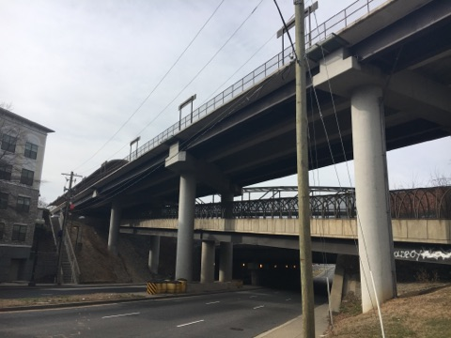
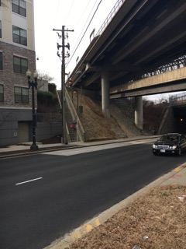
Scaffolding/Fall Protection:
Contractor would need to build up or suspend scaffolding across Rhode Island Ave to reach the concrete ceiling panels.
Contractor requires to complete installation of scaffolding at least one week prior to the shutdown

Slide 17
For Information Only:
Scaffolding and fall protection Subcontractors or other companies can be used by prime contractor:
Scaffold resources Tel: 240-478-9598 (Mark Hill).
Safeway Group Tel: 800-582-9391
Scaffolding Solution Tel: 800-295-9445

Slide 18
Questions ?!!

Slide 19
We will meet on site 1:30 pm at the station kiosk for site visit

